Slide 1
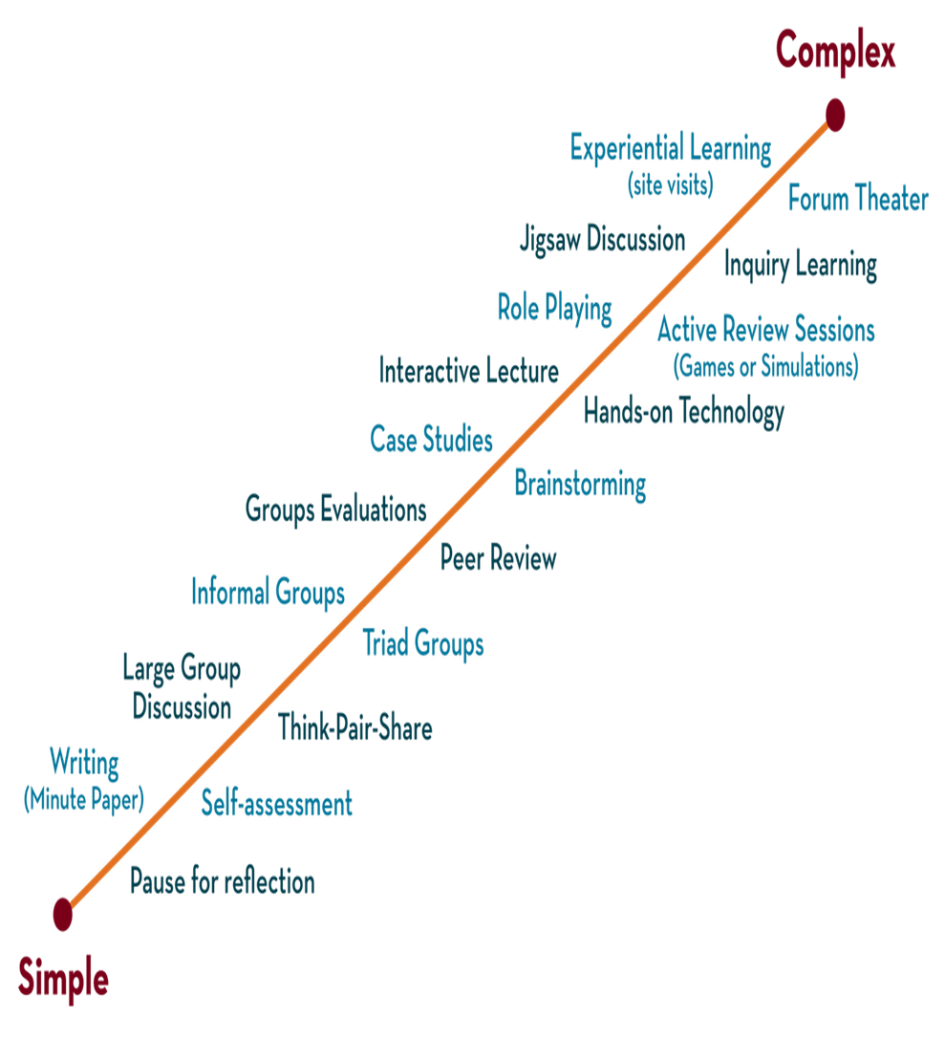
Department of CSE
DESIGN AND ANALYSIS OF ALGORITHMS
24CS2203
Topic:
Job sequencing with deadlines
Greedy Method

Slide 2
Introduction
You are given a set of jobs.
Each job has a defined deadline and some profit associated with it.
The profit of a job is given only when that job is completed within its deadline.
Only one processor is available for processing all the jobs.
Processor takes one unit of time to complete a job.
The problem states- “How can the total profit be maximized if only one job can be completed at a time?”

Slide 3
Algorithm
Greedy Algorithm is adopted to determine how the next job is selected for an optimal solution.
The greedy algorithm described below always gives an optimal solution to the job sequencing problem-
Step-1: Sort all the given jobs in decreasing order of their profit.
Step-2: Check the value of maximum deadline.
Draw a Gantt chart where maximum time on Gantt chart is the value of maximum deadline.
Step-3: Pick up the jobs one by one.
Put the job on Gantt chart as far as possible from 0 ensuring that the job gets completed before its deadline.

Slide 4
Example

Slide 5
Step-1: Sort all the given jobs in decreasing order of their profit

Slide 6
Step-2: Value of maximum deadline = 5.
So, draw a Gantt chart with maximum time on Gantt chart = 5 units as shown-
Now,
We take each job one by one in the order they appear in Step-01.
We place the job on Gantt chart as far as possible from 0.

Slide 7
Step-3: We take job J4. Since its deadline is 2, so we place it in the first empty cell before deadline 2 as
Step-4: We take job J1. Since its deadline is 5, so we place it in the first empty cell before deadline 5 as-

Slide 8
Step-5: We take job J3. Since its deadline is 3, so we place it in the first empty cell before deadline 3 as-
Step-6: We take job J2. Since its deadline is 3, so we place it in the first empty cell before deadline 3. Since the second and third cells are already filled, so we place job J2 in the first cell as-

Slide 9
Step-7: Now, we take job J5. Since its deadline is 4, so we place it in the first empty cell before deadline 4 as-
The only job left is job J6 whose deadline is 2. All the slots before deadline 2 are already occupied. Thus, job J6 cannot be completed.
The optimal schedule is-
J2, J4, J3, J5, J1
This is the required order in which the jobs must be completed in order to obtain the maximum profit.

Slide 10
Maximum earned profit = Sum of profit of all the jobs in optimal schedule
= Profit of job J2 + Profit of job J4 + Profit of job J3 + Profit of job J5 + Profit of job J1
= 180 + 300 + 190 + 120 + 200
= 990 units

Slide 11
Job Sequencing with Deadlines
We are given a set of n jobs.
Deadline d_{i} >= 0 and a profit p_{i} >0 are associated with each job i.
For any job profit is earned if and only if the job is completed by its deadline.
To complete a job, a job has to be processed by a machine for one unit of time. Only one machine is available for processing jobs.
A feasible solution to this problem is a subset of jobs such that each job in this subset can be completed by its deadline
The value of feasible solution J is the sum of the profits of the jobs in J , or
The optimal solution is a feasible solution that will maximize the total profit.
The objective is to find an order of processing of jobs that will maximize the total profit.

Slide 12
Example 1: n = 4, (p₁, p₂, p₃, p₄) = (100,10,15,27) (d₁, d₂, d₃, d₄) = (2, 1, 2, 1)
The maximum deadline is 2 units, hence the feasible solution set must have <=2 jobs.
 | Feasible solution | Processing sequence | value
1 | (1,2) | 2,1 | 110
2 | (1,3) | 1,3 or 3, 1 | 115
3 | (1,4) | 4, 1 | 127
4 | (2,3) | 2, 3 | 25
5 | (3,4) | 4,3 | 42
6 | (1) | 1 | 100
7 | (2) | 2 | 10
8 | (3) | 3 | 15
9 | (4) | 4 | 27
Solution 3 is optimal.

Slide 13
Example 2:
Let n =5 , (P₁,P₂,P₃,P₄,P₅)= (20,15,10,5,1) and (d₁,d₂,d₃,d₄,d₅) = (2,2,1,3,3).
Solution:
The optimal solution is J = {1,2,4} with a profit of 40.
J | Assigned Slots | Jobs Considered | Action | Profit
Ø | None

Slide 14
Example 3:
Let n =7 , (P₁,P₂,P₃,P₄,P₅ ,P₆,P₇)= (3,5,20,18,1,6,30) and
(d₁,d₂,d₃,d₄,d₅,d₆,d₇) = (1,3,4,3,2,1,2).
Solution:
The optimal solution is J = { } with a profit of .
J | Assigned Slots | Jobs Considered | Action | Profit
Ø | None

Slide 15
High level description of jobs sequencing algorithm :
Algorithm GreedyJob(d, j, n)
// J is a set of jobs that their deadlines can complete
{
j : = {1};
for i := 2 to n do
{
if (all jobs in J U {i} can be completed by their deadlines) then
j := j U {i};
}
}

Slide 16
Algorithm JS(d, j, n)
// d[i] ≥ 1, 1 ≤ i ≤ n are the deadlines, n ≥ 1.
// The jobs are ordered such that p[1] ≥ p[2] …… ≥ p[n]
// j[i] is the i^{th} job in the optimal solution, 1 ≤ i ≤ k , at
//termination d [ j[i]] ≤ d[j[i+1]], 1 ≤ i ≤ k
{
d[0] := j[0] := 0; // Initialize
j[1] := 1; // Include job 1
k := 1;

Slide 17
for i := 2 to n do
{ //Consider jobs in Descending order of p[i].
// Find position for i and check feasibility of insertion.
r := k;
while( ( d[ j[r]]> d[i] and ( d[j[r]] ≠ r )) do
r := r - 1;
if( d[i] > r )) then
{
// Insert i into j[].
for q = k to (r+1) step -1 do j[q+1] = j[q];
j[r+1] := i;
k:=k+1;
}
}
return k;
}
Time taken by this algorithm is o(n²)

